Slide 1
Array & Strings in PHP
By
Ekta Makawana

Slide 2
What is an Array?
An array is a special variable, which can hold more than one value at a time.
Array are lists,or lists of lists or lists of lists of lists (multidimensional array)
Each element in the array is assigned its own ID so that it can be easily accessed.
Each elements in array can be address by either number or text values.
Like , $array[key] = value;
If you want to see the structure of an array, use the print_r function to recursively print an array inside of pre tags

Slide 3
3 Kinds of Arrays
Indexed arrays : Arrays with a numeric index
Associative arrays : Arrays with named keys
Multidimensional arrays : Arrays containing one or more arrays

Slide 4
1. Indexed Array (Numeric Array)
A numeric array stores each element with a numeric ID key
There are 2 ways to write a numeric array.
The index can be assigned automatically (index always starts at 0), like this :
Example :
$names = array("Peter","John","Joe");
the index can be assigned manually :
Example :
$names[0] = "Peter";
$names[1] = "John";
$names[2] = "Joe";

Slide 5
The ID can be used in a script
Example:
<?php
$names[0] = "Peter";
$names[1] = "Quagmire";
$names[2] = "Joe";
echo $names[1] . " and " . $names[2] . " are ". $names[0]. "'s neighbours";
?>
Output :
John and Joe are Peter's neighbours

Slide 6
2. Associative Array
Associative arrays are arrays that use named keys that you assign to them.
There are 2 ways to create an associative array.
Way - 1
$ages = array(”Brent"=>42, ”Andrew"=>25, "Joshua”16=>);
Way - 2
$ages[’Brent'] = ”42";
$ages[’Andrew'] = ”25";
$ages['Joshua'] = ”16";

Slide 7
The Named Key can be used in a script
Example:
<?php
$ages[‘Brent’] = ”42";
$ages[‘Andrew’] = ”25";
$ages[‘Joshua’] = ”16";
echo Brent is " . $ages[‘Brent’] . " years old.";
?>
Output :
Brent is 42 years old.

Slide 8
3. Multidimensional Array
A multidimensional array is an array containing one or more arrays.
The dimension of an array indicates the number of indices you need to select an element.
Like , For a two-dimensional array you need two indices to select an element
Way to create multidimensional array
$cars = array (
array("Volvo",22,18),
array("BMW",15,13),
array("Saab",5,2),
array("Land Rover",17,15)
);

Slide 9
Example of Multidimensional Array
$families = array (
"Griffin"=>array (
"Peter",
"Lois",
"Megan" ),
"Quagmire"=>array ( "Glenn" ),
"Brown"=>array (
"Cleveland",
"Loretta",
"Junior" )
);

Slide 10
Output :
Array (
[Griffin] => Array (
[0] => Peter
[1] => Lois
[2] => Megan
)
[Quagmire] => Array (
[0] => Glenn
)
[Brown] => Array (
[0] => Cleveland
[1] => Loretta
[2] => Junior
)
)
Fetch Values from multidimensional array is :
<?php
echo "Is " . $families['Griffin'][2] . " a part of the Griffin family?";
?>
Is Megan a part of the Griffin family?

Slide 11
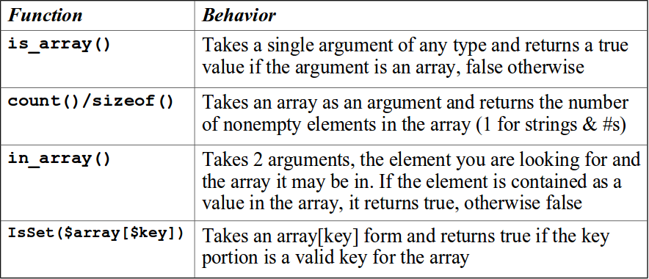
Inspecting arrays

Slide 12
Array Functions
count($ar) - How many elements in an array
is_array($ar) - Returns TRUE if a variable is an array
isset($ar['key']) - Returns TRUE if key is set in the array
sort($ar) - Sorts the array values (loses key)
ksort($ar) - Sorts the array by key
asort($ar) - Sorts array by value, keeping key association
shuffle($ar) - Shuffles the array into random order

Slide 13
$za = array();
$za["name"] = "Chuck";
$za["course"] = "PHPIntro";
print "Count: " . count($za) . "\n";
if ( is_array($za) ) {
echo '$za Is an array' . "\n";
} else {
echo '$za Is not an array' . "\n";
}
echo isset($za['name']) ? "name is set\n" : "name is not set\n";
echo isset($za['addr']) ? "addr is set\n" : "addr is not set\n";
Count: 2
$za Is an array
name is set
addr is not set
Notes:
‹#›

Slide 14
Array(
[name] => Chuck
[course] => PHPIntro
[topic] => PHP
)
Array(
[0] => Chuck
[1] => PHP
[2] => PHPIntro
)
$za = array();
$za["name"] = "Chuck";
$za["course"] = "PHPIntro";
$za["topic"] = "PHP";
print_r($za);
sort($za);
print_r($za);
Notes:
‹#›

Slide 15
Array(
[name] => Chuck
[course] => PHPIntro
[topic] => PHP
)
Array(
[course] => PHPIntro
[name] => Chuck
[topic] => PHP
)
Array(
[name] => Chuck
[topic] => PHP
[course] => PHPIntro
)
$za = array();
$za["name"] = "Chuck";
$za["course"] = "PHPIntro";
$za["topic"] = "PHP";
print_r($za);
ksort($za);
print_r($za);
asort($za);
print_r($za);
Notes:
‹#›

Slide 16
Functions | Behavior
explode() | Explode the string into an array
implode() | Convert array in to the string.
min() & max() | Get the smallest and largest value from an array
array_push() | Used to add the element at the end of the array
array_pop() | Used to remove element from the end of the array
array_slice() | Used to extract particular segment from the array
array_shift() | Used to remove the element from the beginning
array_unique() | Used to remove duplicate elements from the array
array_reverse() | Used to reverse the array
sort() | Used to sort an array
asort() | Used to sort associative array (values are sorted here)
ksort() | Used to sort associative array (keys are sorted here)
array_diff() | Returns the value of first array which are not in second array
array_merge() | Used to merger two array
array_intersect() | Used to find common element in two arrays.

Slide 17
Deleting items from an array :
Functions | Behavior
unset($array[index]) | When deleting an element from an array in PHP, a good function to use is the unset function. This will delete an indexed element from an $array

Slide 18
For more functions details refer below link.
http://php.net/manual/en/language.types.array.php
http://www.w3schools.com/php/php_ref_array.asp

Slide 19
Iterating an arrays
Our favorite iterating construct for looping through an array is foreach
Foreach loop allows to processing entire array without having to pre-evaluate the size of the array.
There are 2 flavors of the foreach statement
foreach (array_expression as $value_var)
loops over the array given by array_expression. On each loop, the value of the current element is assigned to $value_var and the internal array pointer is advanced by one (so on the next loop, you'll be looking at the next element)
foreach (array_expression as $key_var => $value_var)
does the same thing, except that the current element's key will be assigned to the variable $key_var on each loop

Slide 20
When foreach first starts executing, the internal array pointer is automatically reset to the first element of the array. This means that you do not need to call reset() before a foreach loop
Example :
Output :
red
green
blue
yellow
<?php $colors = array("red", "green", "blue", "yellow"); foreach ($colors as $value) { echo "$value <br>"; } ?>

Slide 21
Thank You

